Slide 1
Math 5364 Notes Chapter 4: Classification
Jesse Crawford
Department of Mathematics
Tarleton State University

Slide 2
Today's Topics
Preliminaries
Decision Trees
Hunt's Algorithm
Impurity measures

Slide 3
Preliminaries
Data: Table with rows and columns
Rows: People or objects being studied
Columns: Characteristics of those objects
Rows: Objects, subjects, records, cases, observations, sample elements.
Columns: Characteristics, attributes, variables, features

Slide 4
Dependent variable Y: Variable being predicted.
Independent variables X_{j} : Variables used to make predictions.
Dependent variable: Response or output variable.
Independent variables: Predictors, explanatory variables, control variables, covariates, or input variables.

Slide 5
Nominal variable: Values are names or categories with no ordinal structure.
Examples: Eye color, gender, refund, marital status, tax fraud.
Ordinal variable: Values are names or categories with an ordinal structure.
Examples: T-shirt size (small, medium, large) or grade in a class (A, B, C, D, F).
Binary/Dichotomous variable: Only two possible values.
Examples: Refund and tax fraud.
Categorical/qualitative variable: Term that includes all nominal and ordinal variables.
Quantitative variable: Variable with numerical values for which meaningful arithmetic operations can be applied.
Examples: Blood pressure, cholesterol, taxable income.

Slide 6
Regression: Determining or predicting the value of a quantitative variable using other variables.
Classification: Determining or predicting the value of a categorical variable using other variables.
Classifying tumors as benign or malignant.
Classifying credit card transactions as legitimate or fraudulent.
Classifying secondary structures of protein as alpha-helix, beta-sheet, or random coil.
Classifying a user of a website as a real person or a bot.
Predicting whether a student will be retained/academically successful at a university.

Slide 7
Related fields: Data mining/data science, machine learning, artificial intelligence, and statistics.
Classification learning algorithms:
Decision trees
Rule-based classifiers
Nearest-neighbor classifiers
Bayesian classifiers
Artificial neural networks
Support vector machines

Slide 8


Decision Trees
Name | Body | Skin | Gives | Aquatic | Has | Class
 | Temperature | Cover | Birth | Creature | Legs | Label
Human | Warm-blooded | hair | yes | no | yes | mammal
Python | Cold-blooded | scales | no | no | no | non-mammal
Salmon | Cold-blooded | scales | no | yes | no | non-mammal
Whale | Warm-blooded | hair | yes | yes | no | mammal
Penguin | Warm-blooded | feathers | no | semi | yes | non-mammal
Training
Data
$$⋮$$
$$⋮$$
Body Temperature
Warm-blooded
Cold-blooded
Gives Birth?
Non-mammal
Yes
No
Mammal
Non-mammal

Slide 9
Body Temperature
Warm-blooded
Cold-blooded
Gives Birth?
Non-mammal
Yes
No
Mammal
Non-mammal
Chicken → Classified as non-mammal
Dog → Classified as mammal
Frog → Classified as non-mammal
Duck-billed platypus → Classified as non-mammal (mistake)

Slide 10
Refund
Yes
No
NO
MarSt
Single, Divorced
Married
TaxInc
NO
< 80K
> 80K
NO
YES

Slide 11
Hunt’s Algorithm (Basis of ID3, C4.5, and CART)
N = 10
(7, 3)
No

Slide 12
Hunt’s Algorithm (Basis of ID3, C4.5, and CART)
N = 10
(7, 3)
Refund
Yes
No
NO
NO
N = 3
(3, 0)
N = 7
(4, 3)

Slide 13
Hunt’s Algorithm (Basis of ID3, C4.5, and CART)
N = 10
(7, 3)
Refund
N = 7
(4, 3)
Yes
No
NO
MarSt
Married
N = 3
(3, 0)
Single
Divorced
NO
YES
N = 3
(3, 0)
N = 4
(1, 3)

Slide 14
Hunt’s Algorithm (Basis of ID3, C4.5, and CART)
N = 10
(7, 3)
Refund
N = 7
(4, 3)
Yes
No
NO
MarSt
Married
N = 3
(3, 0)
Single
Divorced
NO
TaxInc
N = 3
(3, 0)
< 80K
> 80K
NO
YES
N = 1
(1, 0)
N = 3
(0, 3)

Slide 15
Impurity Measures
No

Slide 16
Impurity Measures

Slide 17
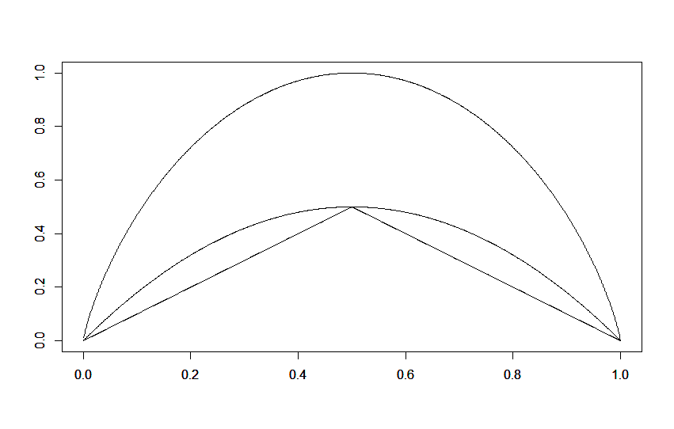
Impurity Measures

Slide 18
Hunt’s Algorithm (Basis of ID3, C4.5, and CART)
N = 10
(7, 3)
No

Slide 19
Hunt’s Algorithm (Basis of ID3, C4.5, and CART)
Refund
Yes
No
NO
NO
N = 3
(3, 0)
N = 7
(4, 3)

Slide 20
Hunt’s Algorithm (Basis of ID3, C4.5, and CART)
Refund
Yes
No
NO
MarSt
Married
N = 3
(3, 0)
Single
Divorced
NO
YES
N = 3
(3, 0)
N = 4
(1, 3)

Slide 21
Hunt’s Algorithm (Basis of ID3, C4.5, and CART)
Refund
Yes
No
NO
MarSt
Married
N = 3
(3, 0)
Single
Divorced
NO
TaxInc
N = 3
(3, 0)
< 80K
> 80K
NO
YES
N = 1
(1, 0)
N = 3
(0, 3)

Slide 22
Types of Splits
Binary Split
Multi-way Split
Marital
Status
Single,
Divorced
Married
Marital
Status
Single
Married
Divorced

Slide 23
Types of Splits

Slide 24
Hunt’s Algorithm Details
Which variable should be used to split first?
Answer: the one that decreases impurity the most.
How should each variable be split?
Answer: in the manner that minimizes the impurity measure.
Stopping conditions:
If all records in a node have the same class label, it becomes a terminal node with that class label.
If all records in a node have the same attributes, it becomes a terminal node with label determined by majority rule.
If gain in impurity falls below a given threshold.
If tree reaches a given depth.
If other prespecified conditions are met.

Slide 25
Today's Topics
Data sets included in R
Decision trees with rpart and party packages
Using a tree to classify new data
Confusion matrices
Classification accuracy

Slide 26
Iris Data Set
Iris Flowers
3 Species: Setosa, Versicolor, and Virginica
Variables: Sepal.Length, Sepal.Width, Petal.Length, and Petal.Width
head(iris)
attach(iris)
plot(Petal.Length,Petal.Width)
plot(Petal.Length,Petal.Width,col=Species)
plot(Petal.Length,Petal.Width,col=c('blue','red','purple')[Species])

Slide 27
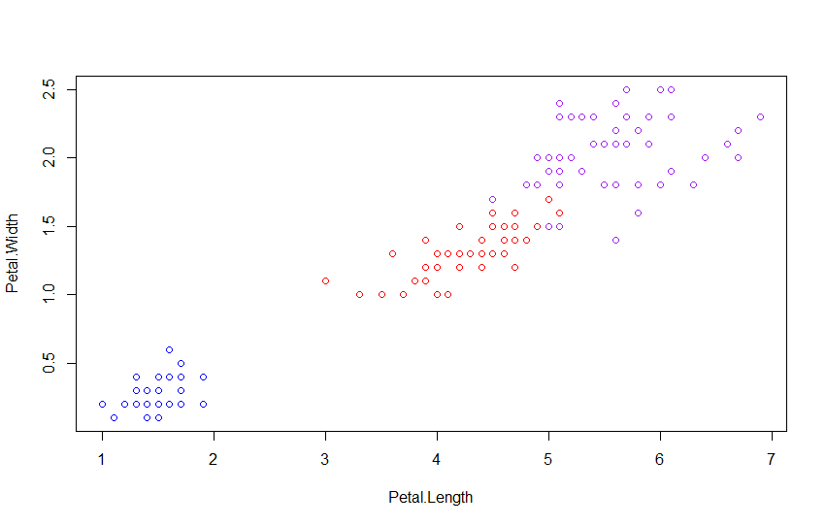
Iris Data Set
plot(Petal.Length,Petal.Width,col=c('blue','red','purple')[Species])

Slide 28
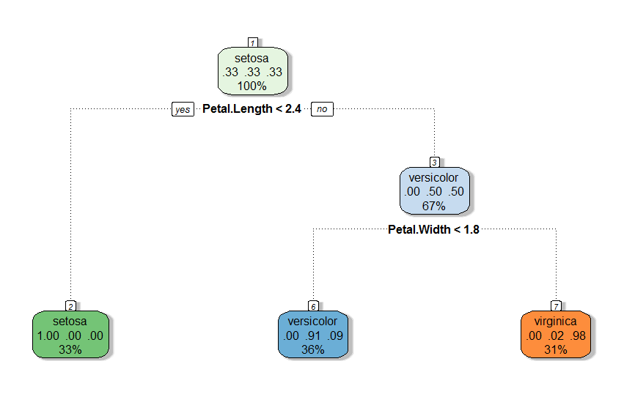
The rpart Package
library(rpart)
library(rattle)
iristree=rpart(Species~Sepal.Length+Sepal.Width+Petal.Length+Petal.Width, data=iris)
iristree=rpart(Species~.,data=iris)
fancyRpartPlot(iristree)

Slide 30

predSpecies=predict(iristree,newdata=iris,type="class")
confusionmatrix=table(Species,predSpecies)
confusionmatrix

Slide 31
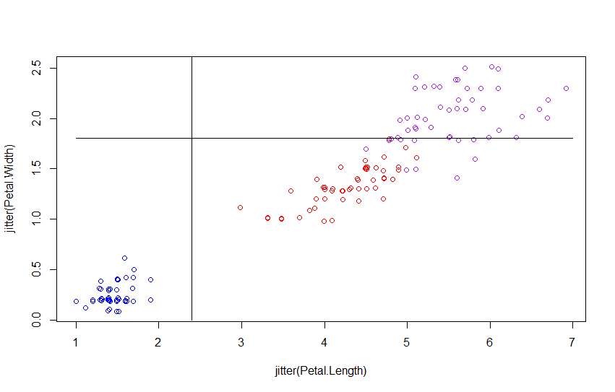
plot(jitter(Petal.Length),jitter(Petal.Width),col=c('blue','red','purple')[Species])
lines(1:7,rep(1.8,7),col='black')
lines(rep(2.4,4),0:3,col='black')

Slide 32
predSpecies=predict(iristree,newdata=iris,type="class")
confusionmatrix=table(Species,predSpecies)
confusionmatrix

Slide 33
Confusion Matrix |  | Predicted Class
 |  | Class = 1 | Class = 0
Actual Class | Class = 1 | f₁₁ | f₁₀
 | Class = 0 | f₀₁ | f₀₀

Slide 34
Accuracy for Iris Decision Tree
accuracy=sum(diag(confusionmatrix))/sum(confusionmatrix)
The accuracy is 96%
Error rate is 4%

Slide 35
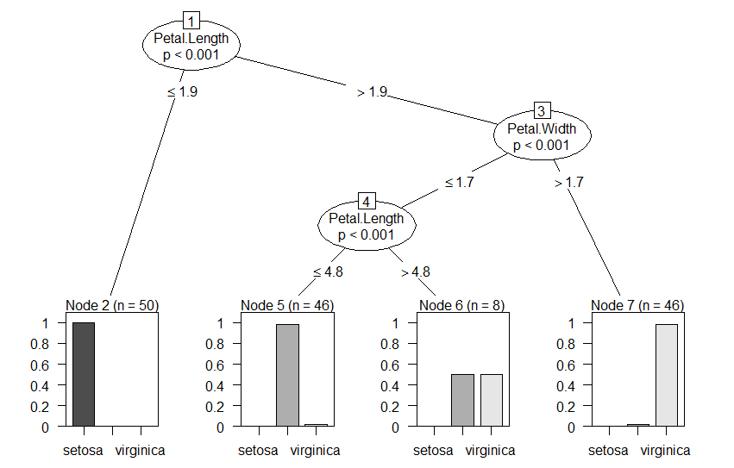
The party Package
library(party)
iristree2=ctree(Species~.,data=iris)
plot(iristree2)

Slide 36
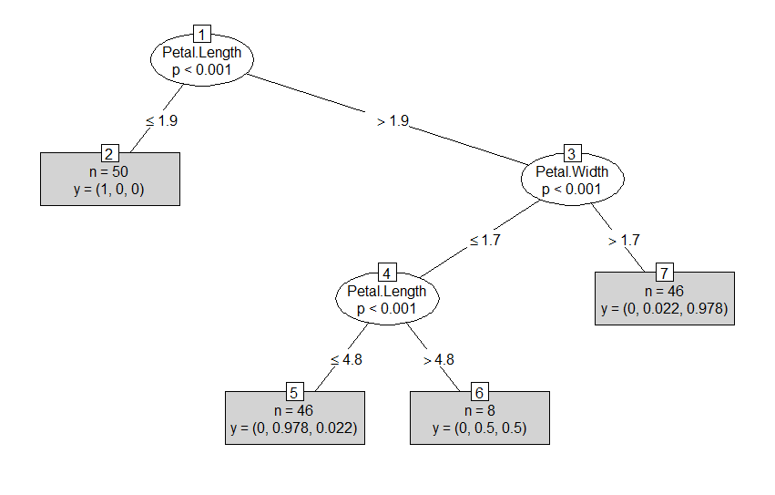
The party Package
plot(iristree2,type='simple')

Slide 37
Predictions with ctree
predSpecies=predict(iristree2,newdata=iris)
confusionmatrix=table(Species,predSpecies)
confusionmatrix

Slide 38
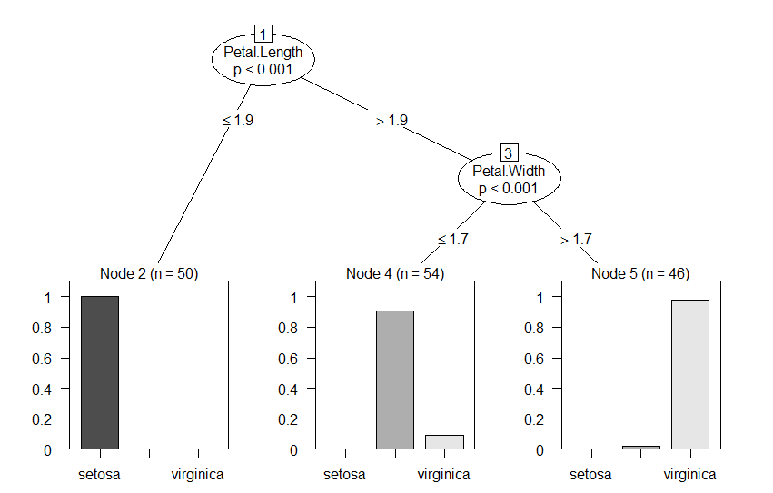
iristree3=ctree(Species~.,data=iris, controls=ctree_control(maxdepth=2))
plot(iristree3)

Slide 39
Today's Topics
Training and Test Data
Training error, test error, and generalization error
Underfitting and Overfitting
Confidence intervals and hypothesis tests for classification accuracy

Slide 40
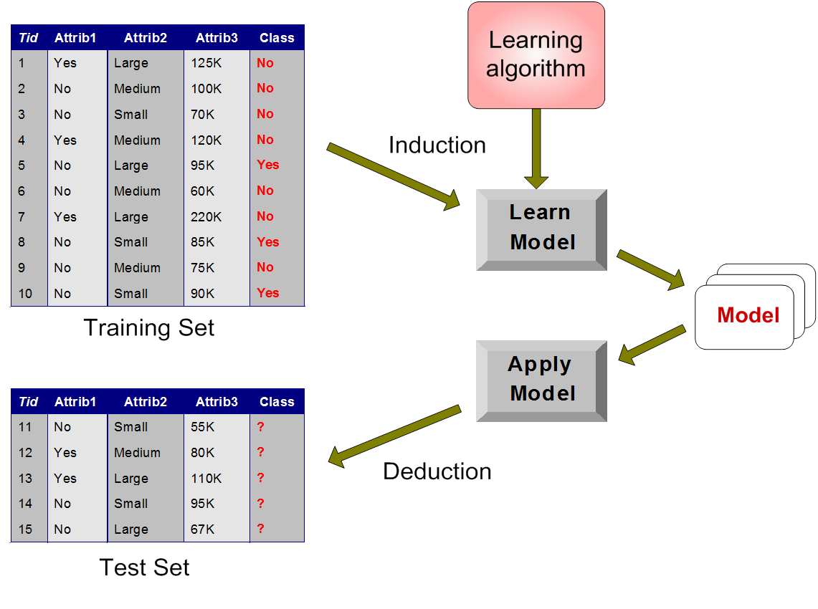
Training and Testing Sets

Slide 41
Training and Testing Sets
Divide data into training data and test data.
Training data: used to construct classifier/statisical model
Test data: used to test classifier/model
Types of errors:
Training error rate: error rate on training data
Generalization error rate: error rate on all nontraining data
Test error rate: error rate on test data
Generalization error is most important
Use test error to estimate generalization error
Entire process is called cross-validation

Slide 42
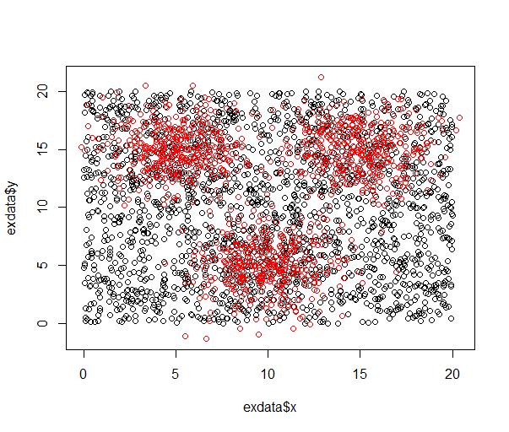
Example Data

Slide 43
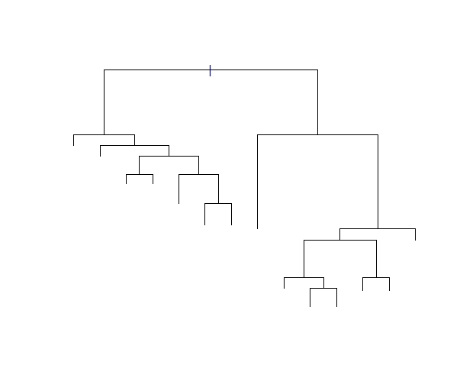
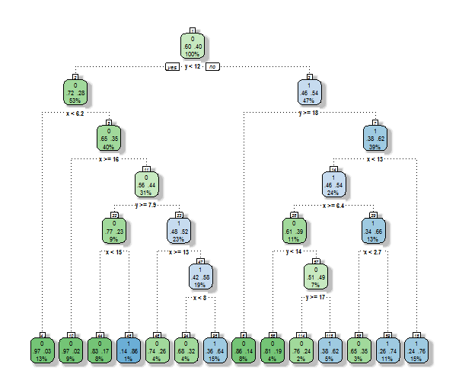
Split 30% training data and 70% test data.
extree=rpart(class~.,data=traindata)
fancyRpartPlot(extree)
plot(extree)
Training accuracy = 79%
Training error = 21%
Testing error = 29%
dim(extree$frame)
Tells us there are 27 nodes

Slide 44
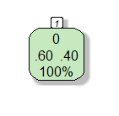
Training error = 40%
Testing error = 40%
1 Nodes

Slide 45
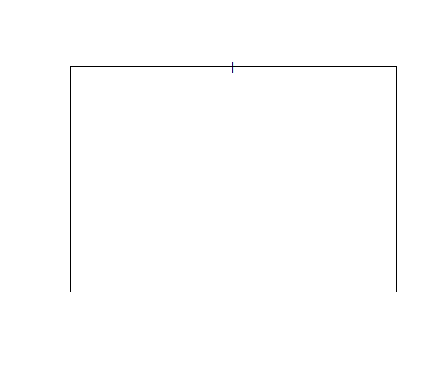
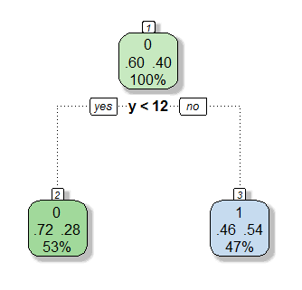
extree=rpart(class~.,data=traindata, control=rpart.control(maxdepth=1))
Training error = 36%
Testing error = 39%
3 Nodes

Slide 46
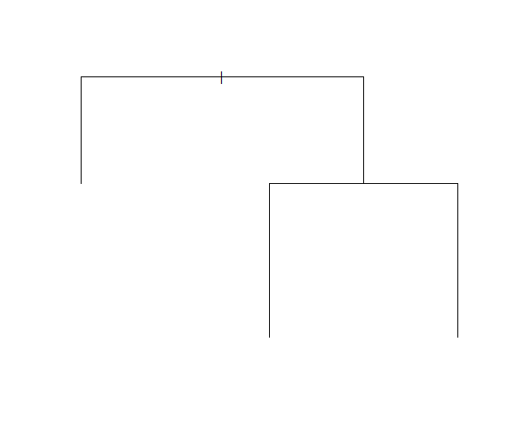
extree=rpart(class~.,data=traindata, control=rpart.control(maxdepth=2))
Training error = 30%
Testing error = 34%
5 Nodes

Slide 47
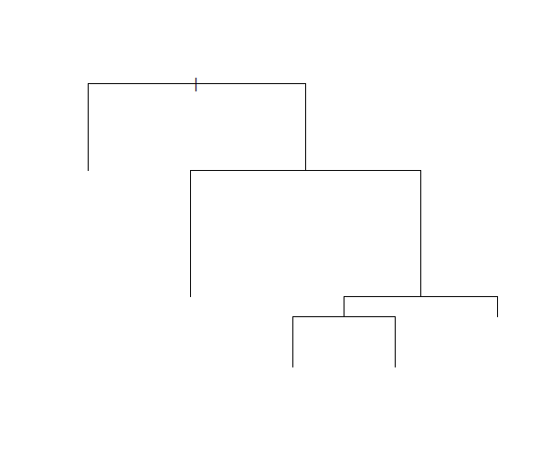
extree=rpart(class~.,data=traindata, control=rpart.control(maxdepth=4))
Training error = 28%
Testing error = 34%
9 Nodes

Slide 48
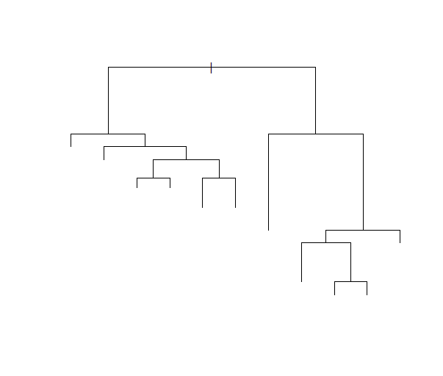
extree=rpart(class~.,data=traindata, control=rpart.control(maxdepth=5))
Training error = 24%
Testing error = 30%
21 Nodes

Slide 49
extree=rpart(class~.,data=traindata, control=rpart.control(maxdepth=6))
Training error = 21%
Testing error = 29%
27 Nodes

Slide 50
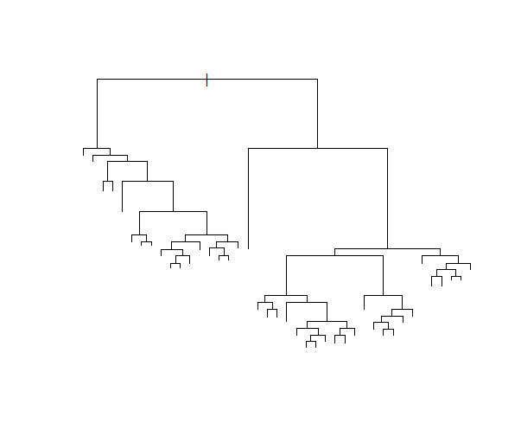
extree=rpart(class~.,data=traindata, control=rpart.control(minsplit=1,cp=0.004))
Default value of cp is 0.01
Lower values of cp make tree more complex
Training error = 16%
Testing error = 30%
81 Nodes

Slide 51
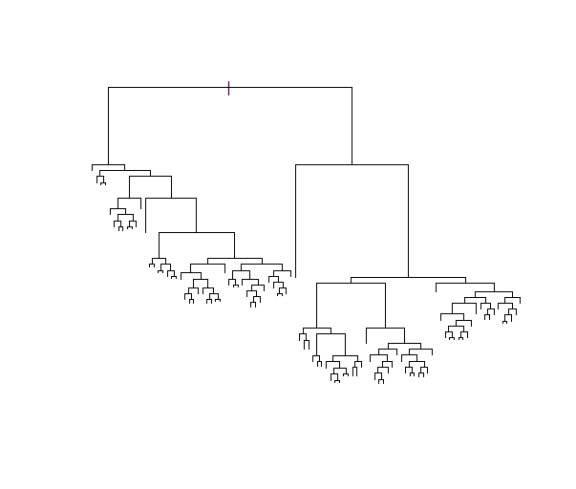
extree=rpart(class~.,data=traindata, control=rpart.control(minsplit=1,cp=0.0025))
Default value of cp is 0.01
Lower values of cp make tree more complex
Training error = 9%
Testing error = 31%
195 Nodes

Slide 52
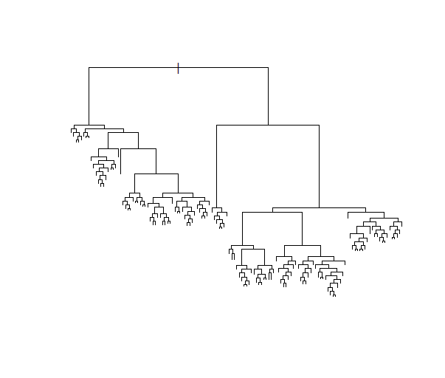
extree=rpart(class~.,data=traindata, control=rpart.control(minsplit=1,cp=0.0015))
Default value of cp is 0.01
Lower values of cp make tree more complex
Training error = 6%
Testing error = 33%
269 Nodes

Slide 53
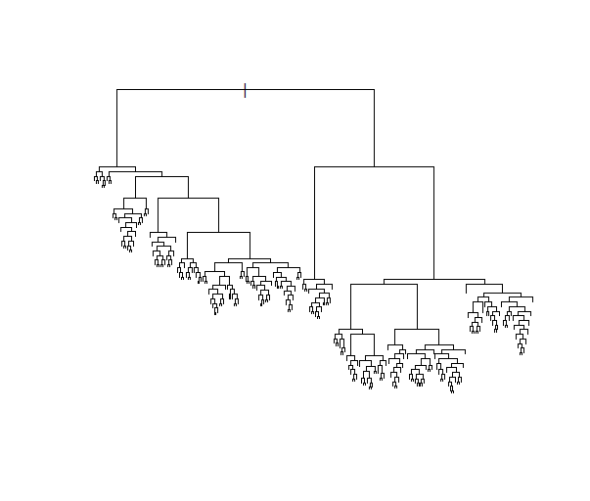
extree=rpart(class~.,data=traindata, control=rpart.control(minsplit=1,cp=0))
Default value of cp is 0.01
Lower values of cp make tree more complex
Training error = 0%
Testing error = 34%
477 Nodes

Slide 54
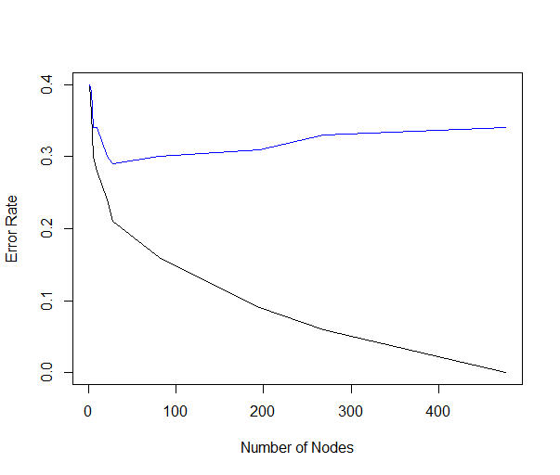
Testing Error
Training Error

Slide 55
Underfitting and Overfitting
Underfitting: Model is not complex enough
High training error
High generalization error
Overfitting: Model is too complex
Low training error
High generalization error

Slide 56
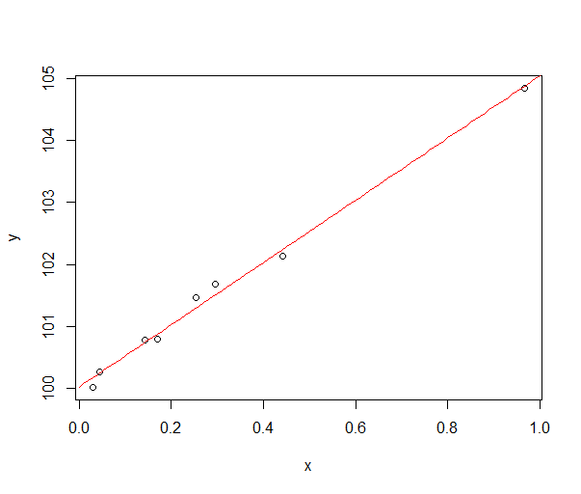
A Linear Regression Example
Training error = 0.0129

Slide 57
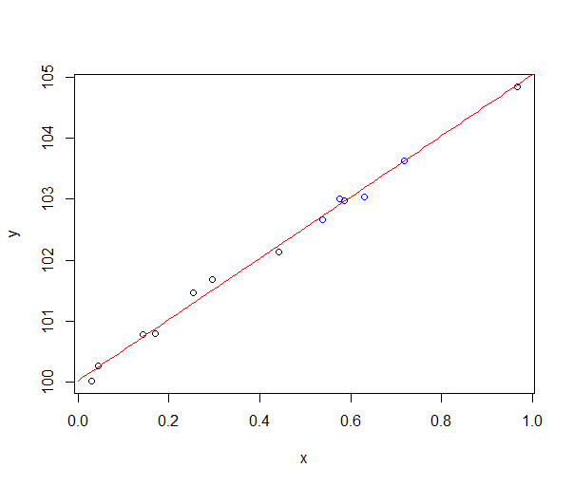
A Linear Regression Example
Training error = 0.0129
Test error = 0.00640

Slide 58
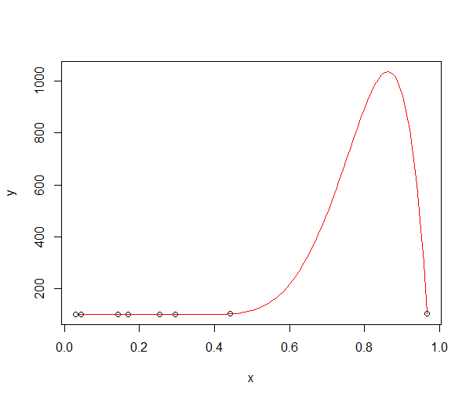
A Linear Regression Example
Training error = 0

Slide 59
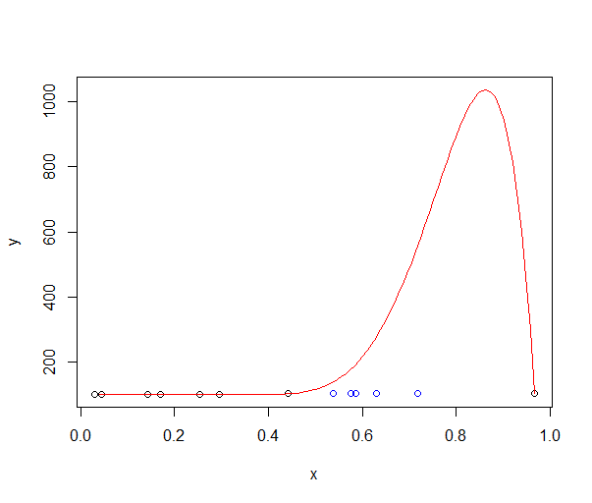
A Linear Regression Example
Training error = 0
Test error = 50458.33

Slide 60
Occam's Razor
Occam's Razor/Principle of Parsimony:
Simpler models are preferred to more complex models,
all other things being equal.

Slide 61
Confidence Interval for
Classification Accuracy

Slide 62
Confidence Interval for Example Data
(0.6888, 0.7276)
(0.6891, 0.7280)

Slide 63
Exact Binomial Confidence Interval
binom.test(1488,2100)
(0.6886, 0.7279)

Slide 64
Comparing Two Classifiers
 | Classifier 2 Correct | Classifier 2 Incorrect
Classifier 1 Correct | a | b
Classifier 1 Incorrect | c | d
a, b, c, and d
Number of records in each category

Slide 65
Exact McNemar Test
library(exact2x2)
Use the mcnemar.exact function

Slide 66
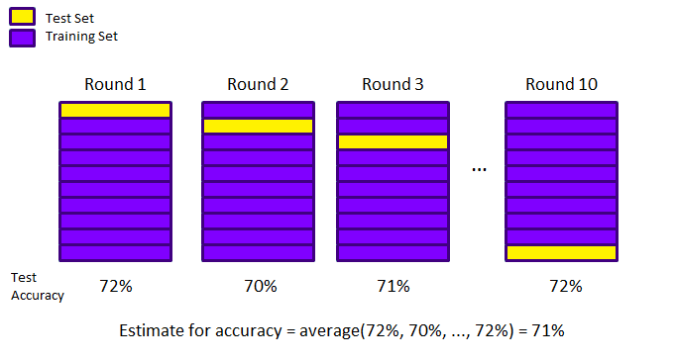
K-fold Cross-validation

Slide 67
Other Types of Cross-validation
Leave-one-out CV
For each record
Use that record as a test set
Use all other records as a training set
Compute accuracy
Afterwards, average all accuracies
(Equivalent to K-fold CV with K = n)
Delete-d CV
Repeat the following m times:
Randomly select d records
Use those d records as a test set
Use all other records as a training set
Compute accuracy
Afterwards, average all accuracies
n = Number of records
in original data

Slide 68
Other Types of Cross-validation
Bootstrap
Repeat the following b times:
Randomly select n records with replacement
Use those n records as a training set
Use all other records as a test set
Compute accuracy
Afterwards, average all accuracies
n = Number of records
in original data

